Slide 1
Responsive Web Design
K00233562
Assignment 1

Slide 2
About the site
3 persona’s with music background
Music Producer
Artist (Gtr and vocalist)
Music Fanatic
Two Specific Questions asked:
What information would you like in a music based website?
What functions would you expect or like to see (i.e.. social media, search option, comment section)?

Slide 3
Responses
Wide varieties of taste as most decent musical people have an eclectic preference in music.
Proper links to related music i.e. if you like this, check out …
Information on whats going coming up, i.e Events, ticket information….
A website that it tailored by genre but doesn’t focus solely on the scandal in artists lives. It should look at albums, awards, events and even new technology in the industry, to cater for more than the musicians in the industry.

Slide 4
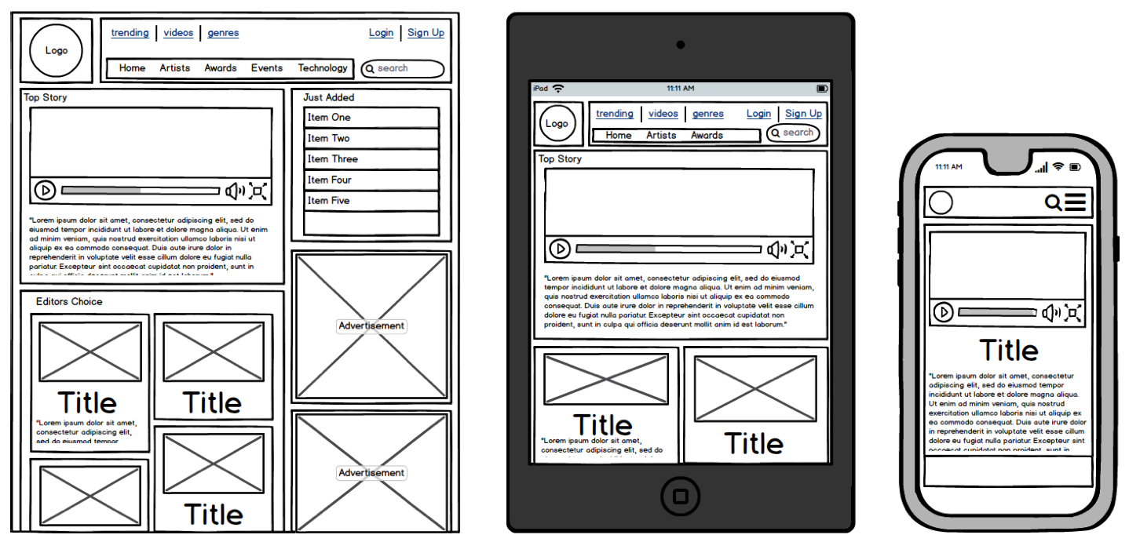
Wireframes for original design

Slide 5
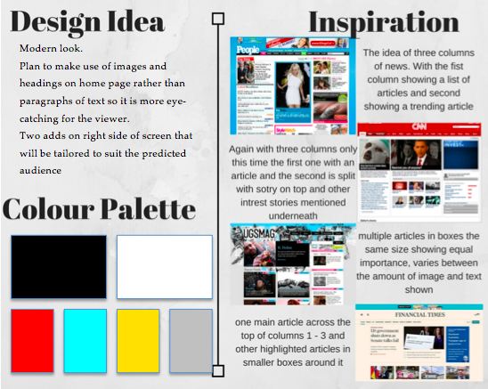
Moodboard

Slide 6
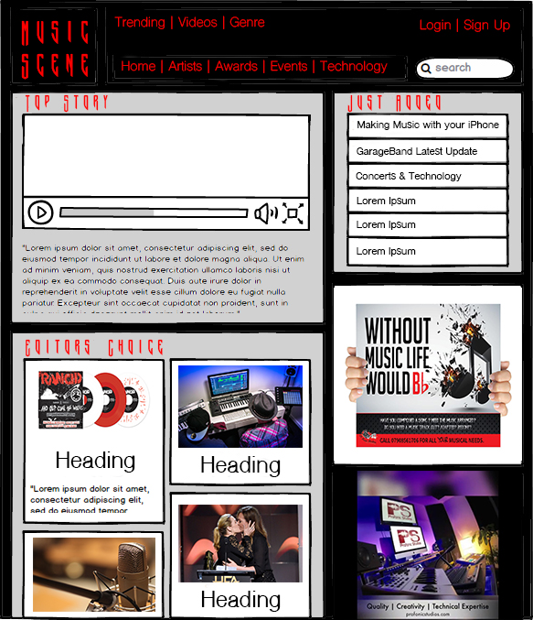
Photoshop Design of Design Idea
What changed
Less pages than in picture
Would add them if planning further development of website but did not want pages not linked to anything
“Just added” section was not put in as didn’t have enough articles
The right hand column was removed, adds were put to the end of the site home page but the rest remained similar.

Slide 7


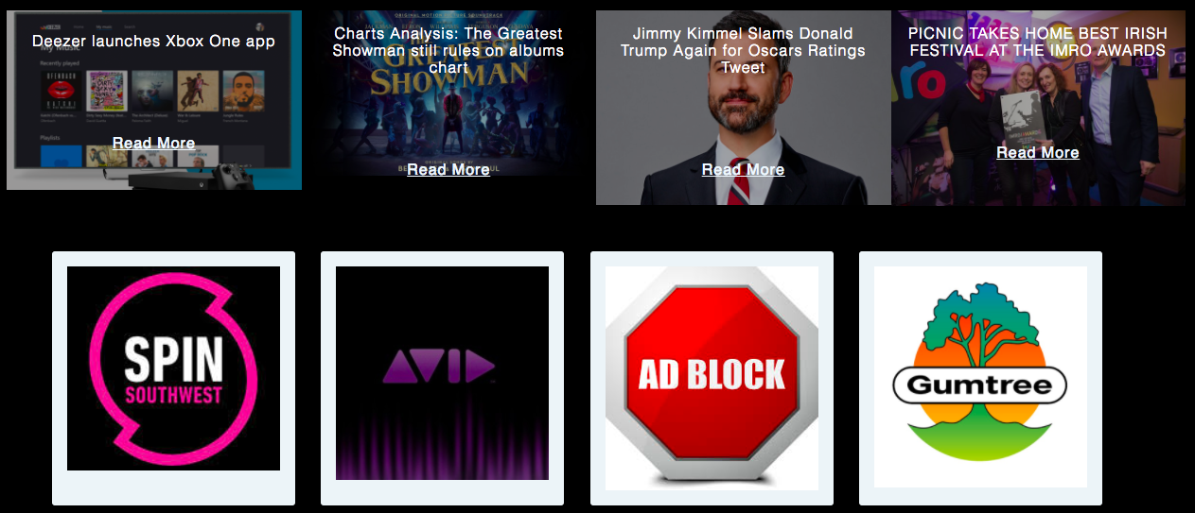
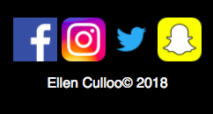
Music Scene

Slide 8
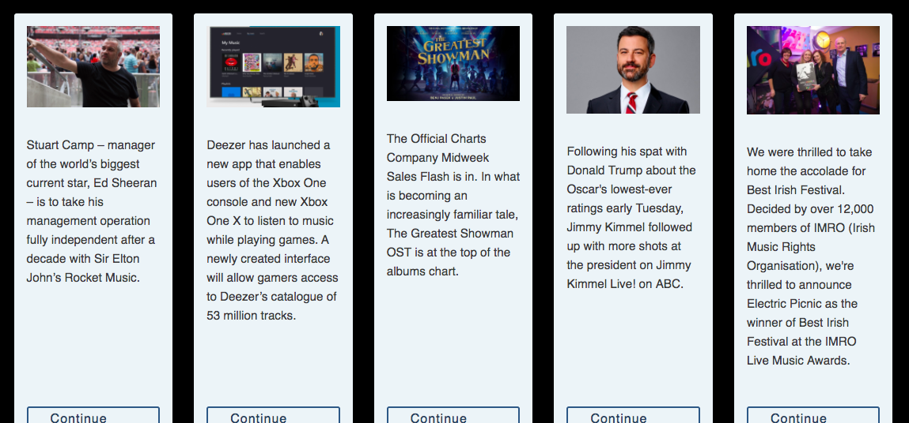
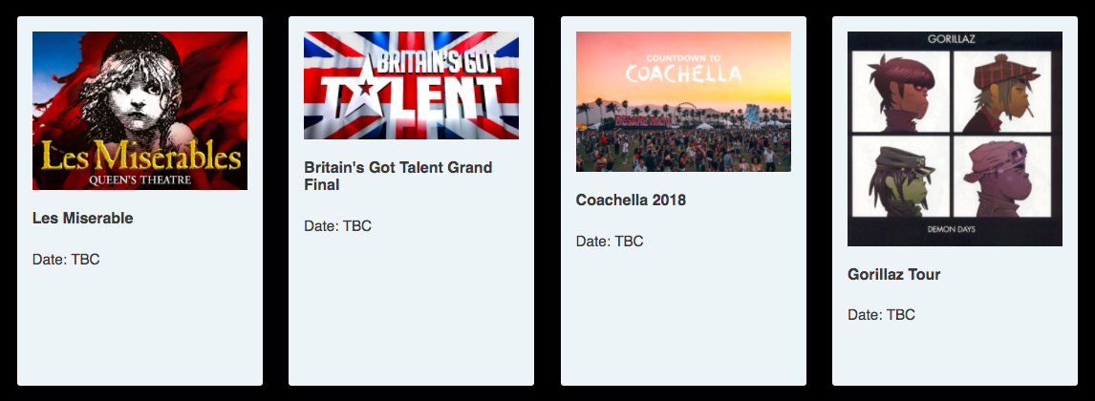

Slide 9
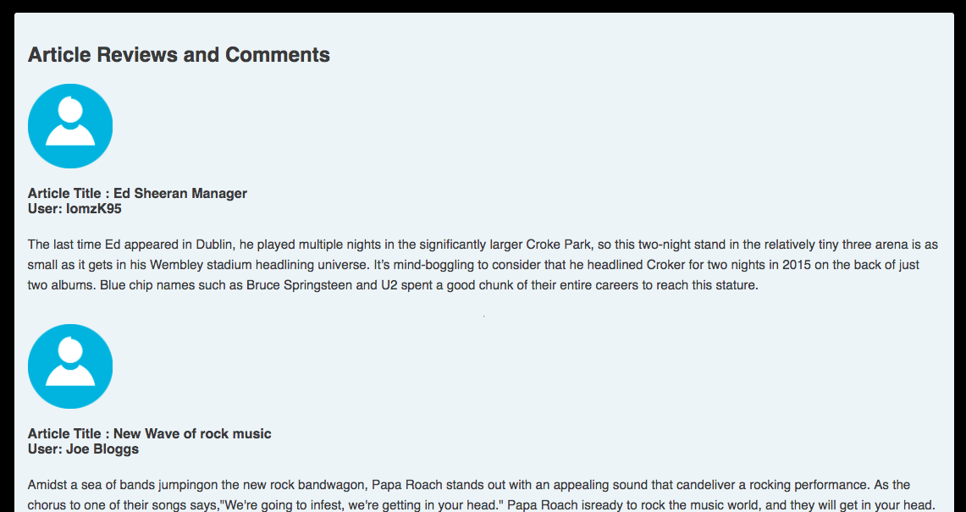
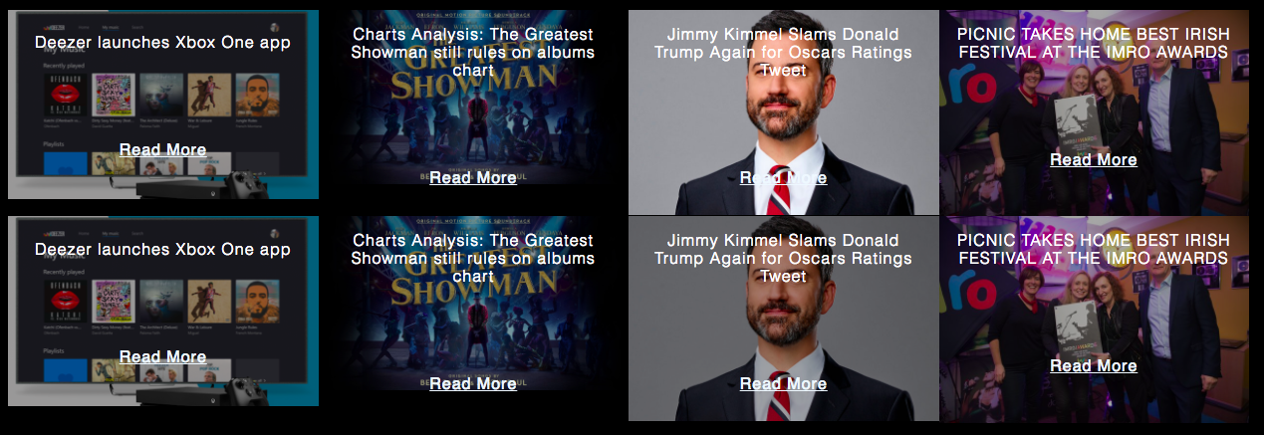

Slide 10
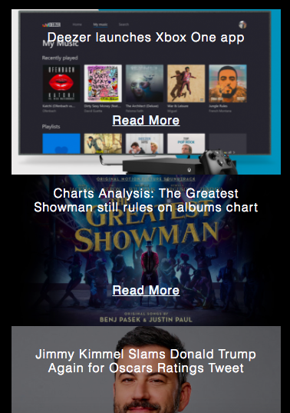
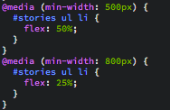
For each component I set the width and a percentage so that the object would decrease or increase when it hit that many pixels on screen.

Slide 11
Any Questions ??

